Slide 1


Arrays
Nazrin Dolkhanova Sultanli
Programming and Computer Applications – 1

Slide 2



Agenda
Array declaration: uninitialized
Array declaration: initialized
Looping Through Arrays
Multidimensional Arrays
Multidimensional Arrays Loop
Pass Arrays to a Function
Size of Array
Array String
Array String: loop
Concatenating Strings
Copying Strings

Slide 3

Topic four
Arrays

Slide 4
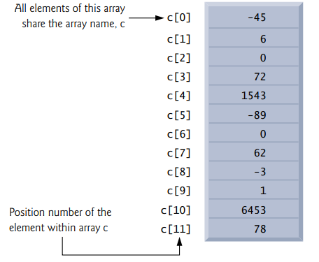
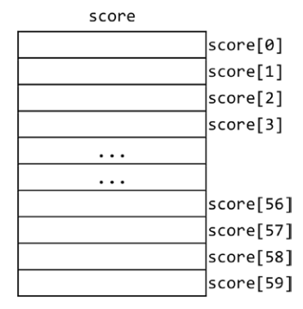
4.1 Array declaration: uninitialized
DataType ArrayName[SizeOfArray];
int score[60];
An array declaration consists of
The type (int, in this example)
The name of the array (score, in this example)
A left square bracket, [
The size of the array (60, in this example)
A right square bracket, ]
When you create an uninitialized array, you are required to specify its size so that the compiler may reserve the proper amount of memory blocks.
score[0] refers to the 1st score
score[1] refers to the 2nd score
score[2] refers to the 3rd score
.
score[58] refers to the 59th score
score[59] refers to the 60th score
It is an error to try to refer to an element that is outside the range of subscripts allowed. If you do, you will get an “array subscript” error. For example, you cannot refer to score[60], score[-1] and score[99] since they do not exist.

Slide 5
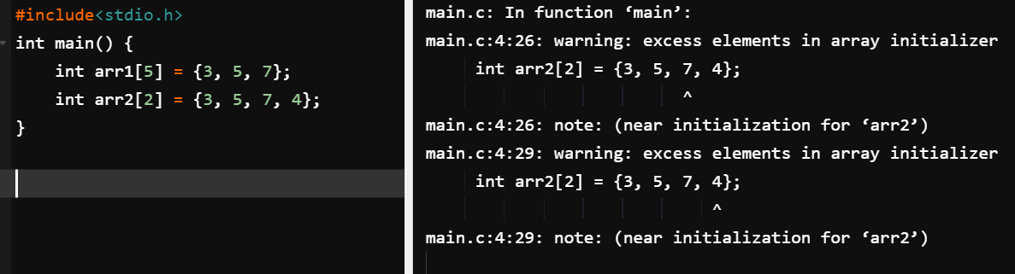
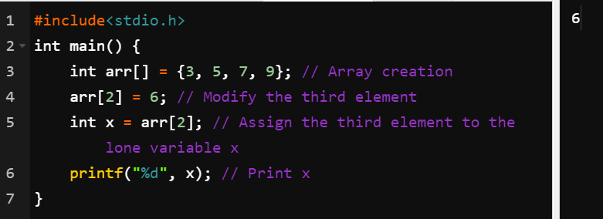
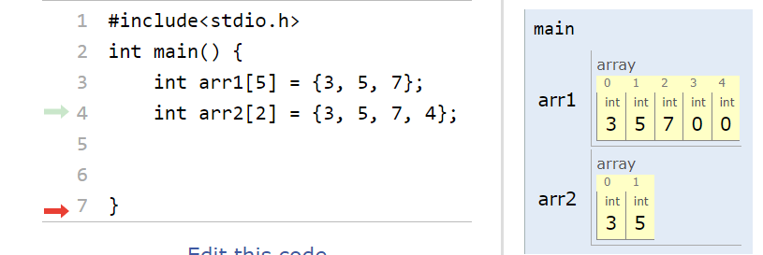
4.1 Array declaration: initialized
dataType name[] = {firstValue, secondValue, thirdValue, …};
int age[] = {7, 27, 34, 63};
Notice that in this case, you don’t need to specify the size of the array as it is implied from the number of elements supplied; however, declaring an initialized array with the size specified will also work.
int age[4] = {7, 27, 34, 63};
If fewer than 4 values are supplied, then 0s would be used to fill out the array. If more than 4 values are supplied, you would get a warning or an error, depending on your compiler setting.
Array elements can be accessed, modified, and used just like any other variable of the same data type. The following shows how to access an element in an array at index idx:
arr[idx]
An element in an array is modified just like a regular variable:
arr[idx] = newValue
Notes:
#include<stdio.h> int main() { int arr[] = {3, 5, 7, 9}; // Array creation arr[2] = 6; // Modify the third element int x = arr[2]; // Assign the third element to the lone variable x printf("%i", x); // Print x }

Slide 6
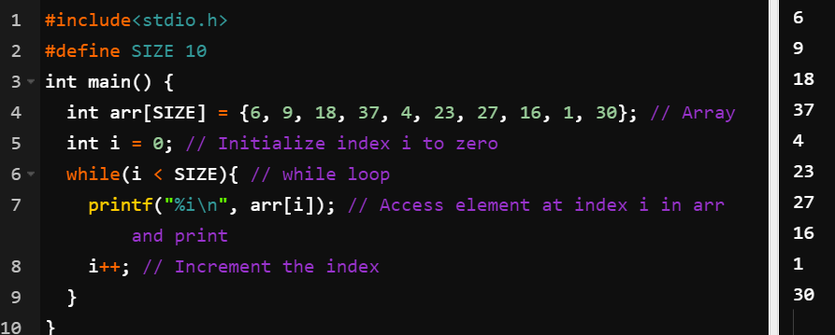
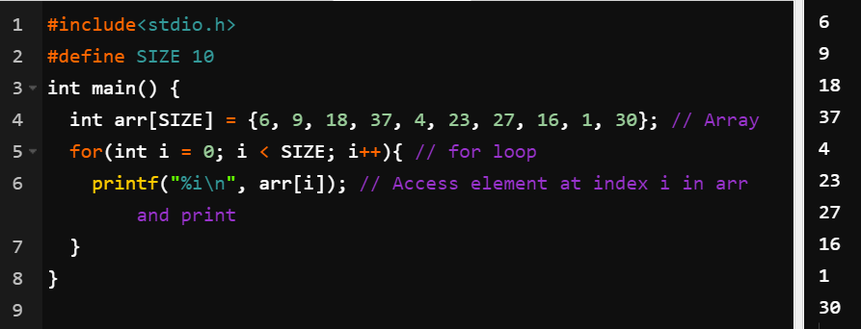
4.2 Looping Through Arrays
Notes:
#include<stdio.h>
#define SIZE 10
int main() {
int arr[SIZE] = {6, 9, 18, 37, 4, 23, 27, 16, 1, 30}; // Array
int i = 0; // Initialize index i to zero
while(i < SIZE){ // while loop
printf("%i\n", arr[i]); // Access element at index i in arr and print
i++; // Increment the index
}
}

Slide 7
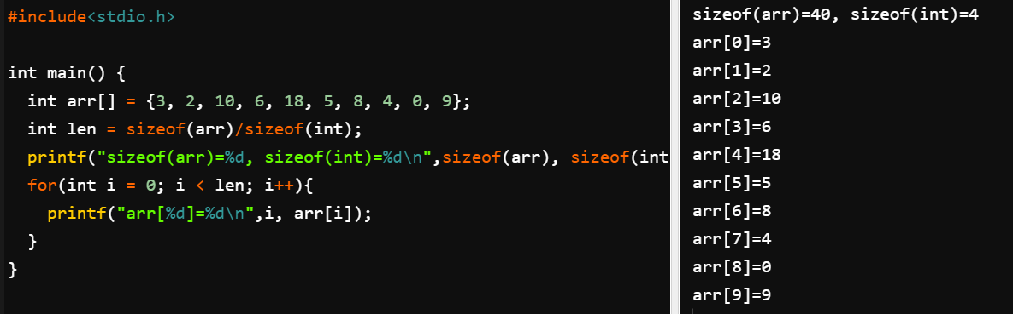
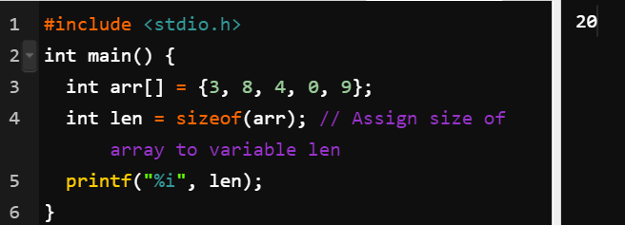
4.3 Size of Array
The array has five elements in it, however, this code will output the number 20 as opposed to five because sizeof() returns the total number of bytes occupied by the array regardless of the type of elements. Recall that a variable occupies several bytes in memory determined by its type. In this case, the array has five integers each of which occupies four bytes of memory; therefore the total size is 5 x 4 = 20 bytes. To get the actual number of elements in the array, we have to divide the total size of the array by the size of the data type it contains. Fortunately, the sizeof() function can also be applied to any data type to determine its size in memory. The syntax is the same as that for an array:
sizeof(dataType);
// Assign size of array to variable len. Scale by the size of an int. int len = sizeof(arr)/sizeof(int);
datatypeOfArray len = sizeof(arr)/sizeof(datatypeOfArray);
Notes:
#include<stdio.h>
int main() {
int arr[] = {3, 2, 10, 6, 18, 5, 8, 4, 0, 9};
int len = sizeof(arr)/sizeof(int);
printf("sizeof(arr)=%d, sizeof(int)=%d\n",sizeof(arr), sizeof(int));
for(int i = 0; i < len; i++){
printf("arr[%d]=%d\n",i, arr[i]);
}
}

Slide 8
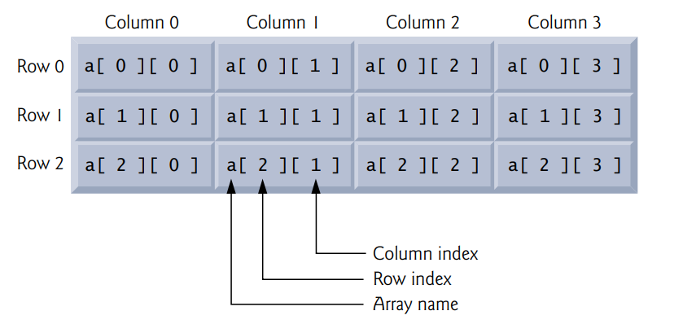
4.4 Multidimensional Arrays
int mat[3][4];
The array mat contains three elements each of which is an array that contains four integers. To visualize this, consider a row of three lockers, in which each locker contains four sub-lockers that someone can store items in. To illustrate how to create an initialized multidimensional array,
int mat2[][3] = {{1, 6, 3}, {5, 9, 2}};
Just like in the single dimension case, the array is initialized by placing elements between {} brackets. In this case, the elements inside the outermost brackets are arrays of three elements each. It is important to note that while the two-by-three dimension can be inferred from the right-hand side of the expression, the only dimension that can be omitted is the first (notice the first [] is empty); all others must be supplied. The array mat2, represents this table:
While it is possible to have a theoretically infinite number of dimensions, in practice, dimensions greater than two are very rare. For a two-dimensional matrix, the first dimension represents the number of rows and the second dimension represents the number of columns.
array[rowNumber - 1][columnNumber - 1];
Similar to their single dimension counterparts, the first row is at index 0, the nth row is at index n-1, and the last row is at index firstDim - 1. This is the same for the columns too.
int mat[][3] = {{19, 6, 7}, {20, 3, 17}, {16, 13, 10}};
To access the element on the second row and third column, we write mat[1][2] (in this case it’s 17).
1 | 6 | 3
5 | 9 | 2

Slide 9
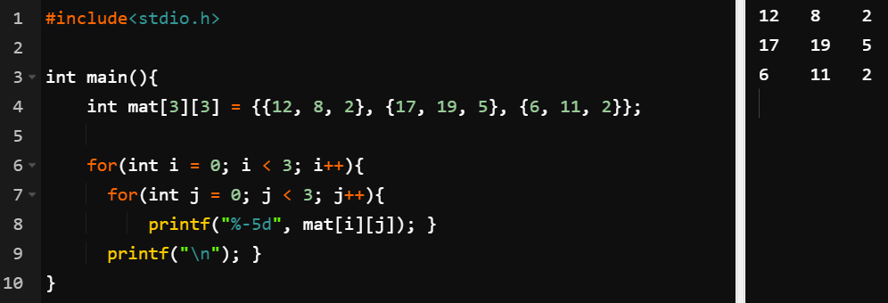
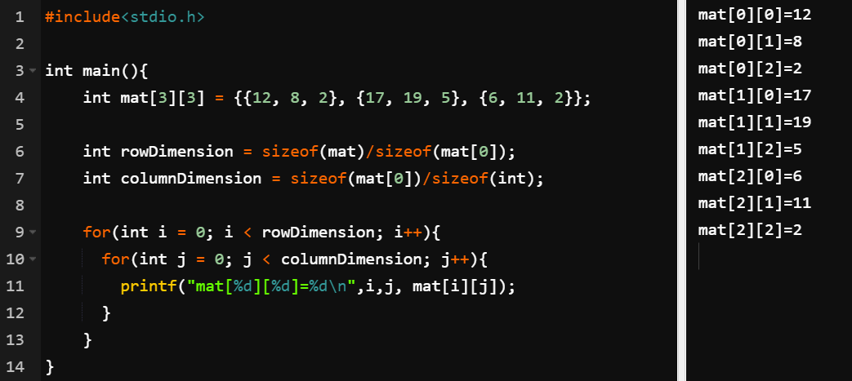
4.5 Multidimensional Arrays Loop
To prevent the hardcoding of dimensions in a loop, the sizeof() function is used as follows:
• rowDimension = sizeof(matrix)/sizeof(matrix[0]);
• columnDimension = sizeof(matrix[0])/sizeof(dataType);
Notes:
#include<stdio.h>
int main(){
int mat[3][3] = {{12, 8, 2}, {17, 19, 5}, {6, 11, 2}};
int rowDimension = sizeof(mat)/sizeof(mat[0]);
int columnDimension = sizeof(mat[0])/sizeof(int);
for(int i = 0; i < rowDimension; i++){
for(int j = 0; j < columnDimension; j++){
printf("mat[%d][%d]=%d\n",i,j, mat[i][j]);
}
}
}
#include<stdio.h>
int main(){
int mat[3][3] = {{12, 8, 2}, {17, 19, 5}, {6, 11, 2}};
for(int i = 0; i < 3; i++){
for(int j = 0; j < 3; j++){
printf("%-5d", mat[i][j]); }
printf("\n"); }
}

Slide 10
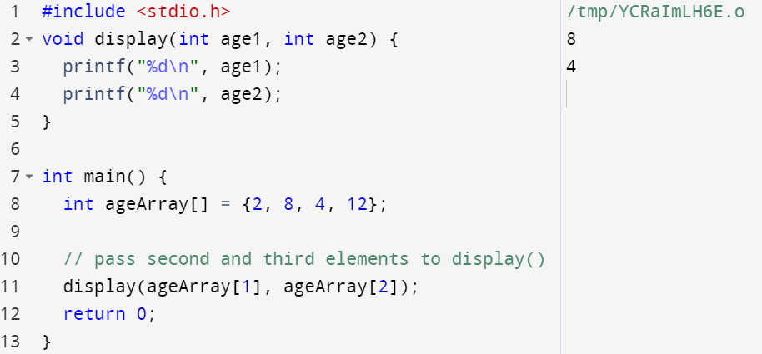
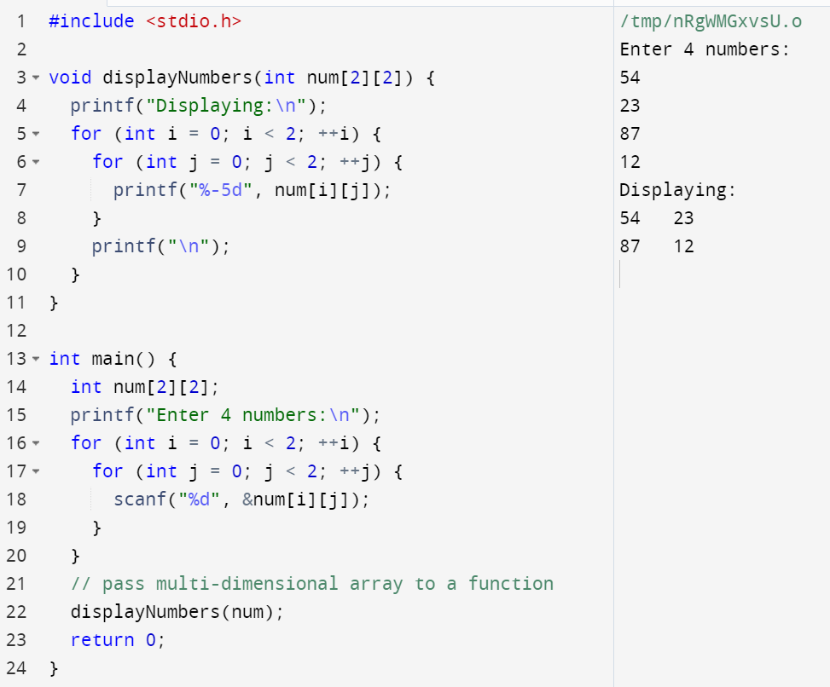
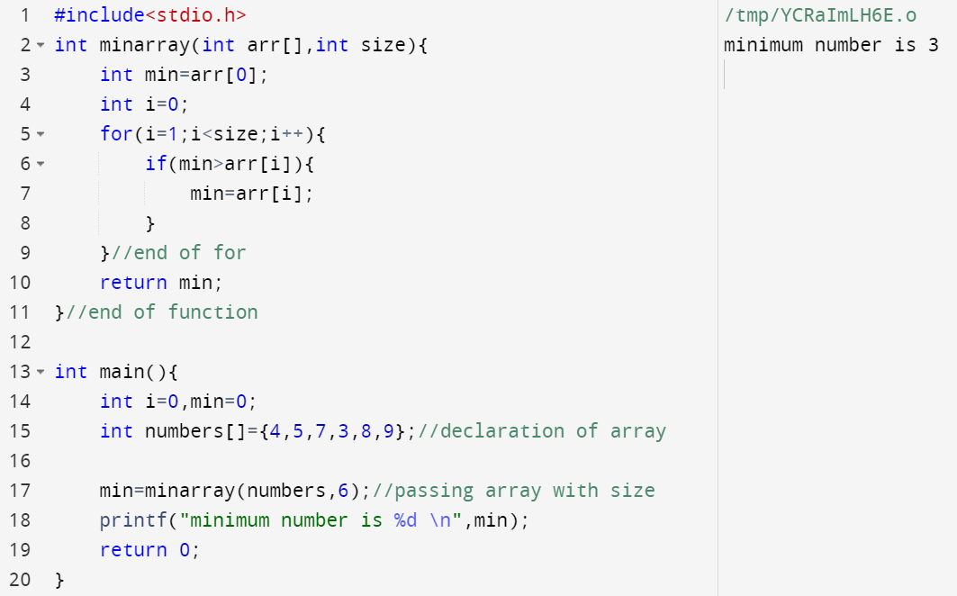
4. 6 Pass Arrays to a Function
Pass Individual Array Elements
Pass two-dimensional arrays
Pass Arrays to Functions
Notes:
#include <stdio.h>void display(int age1, int age2) { printf("%d\n", age1); printf("%d\n", age2);}int main() { int ageArray[] = {2, 8, 4, 12}; // pass second and third elements to display() display(ageArray[1], ageArray[2]); return 0;}
#include<stdio.h>
int minarray(int arr[],int size){
int min=arr[0];
int i=0;
for(i=1;i<size;i++){
if(min>arr[i]){
min=arr[i];
}
}//end of for
return min;
}//end of function
int main(){
int i=0,min=0;
int numbers[]={4,5,7,3,8,9};//declaration of array
min=minarray(numbers,6);//passing array with size
printf("minimum number is %d \n",min);
return 0;
}
#include <stdio.h>void displayNumbers(int num[2][2]) { printf("Displaying:\n"); for (int i = 0; i < 2; ++i) { for (int j = 0; j < 2; ++j) { printf("%-5d", num[i][j]); } printf("\n"); }}int main() { int num[2][2]; printf("Enter 4 numbers:\n"); for (int i = 0; i < 2; ++i) { for (int j = 0; j < 2; ++j) { scanf("%d", &num[i][j]); } } // pass multi-dimensional array to a function displayNumbers(num); return 0;}

Slide 11
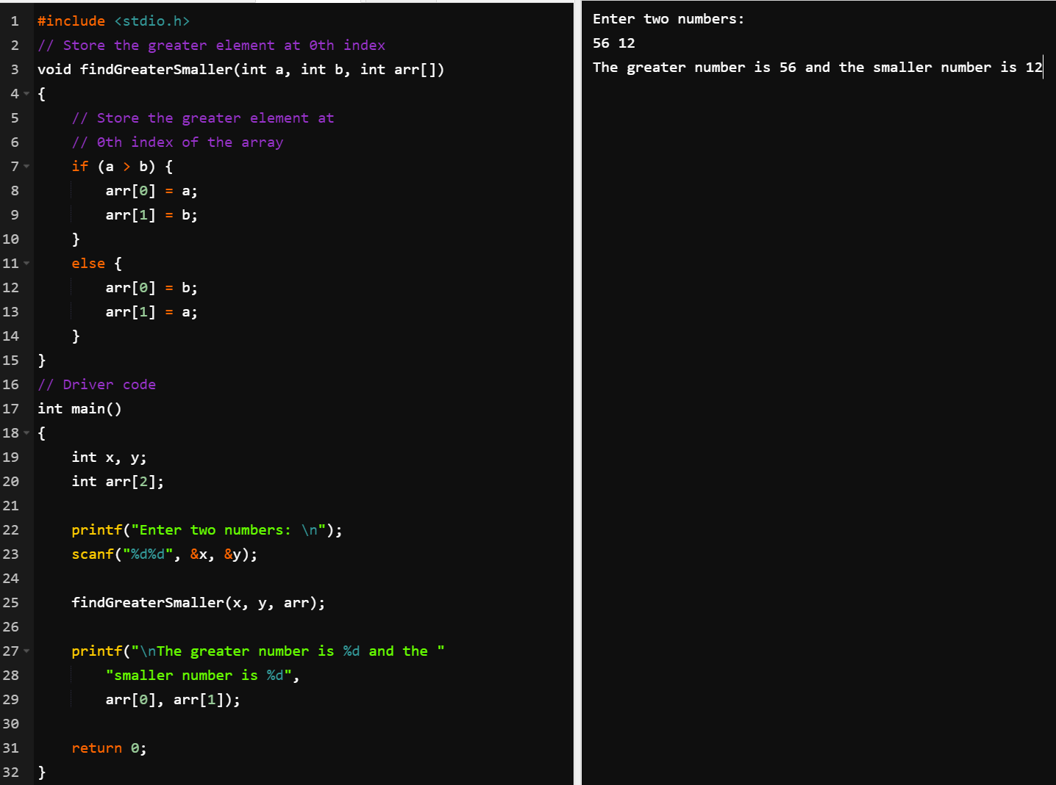
4. 6 Pass Arrays to a Function
Example for returning two variables from function using array ( with non return type function)
Notes:
#include <stdio.h>
// Store the greater element at 0th index
void findGreaterSmaller(int a, int b, int arr[])
{
// Store the greater element at
// 0th index of the array
if (a > b) {
arr[0] = a;
arr[1] = b;
}
else {
arr[0] = b;
arr[1] = a;
}
}
// Driver code
int main()
{
int x, y;
int arr[2];
printf("Enter two numbers: \n");
scanf("%d%d", &x, &y);
findGreaterSmaller(x, y, arr);
printf("\nThe greater number is %d and the "
"smaller number is %d",
arr[0], arr[1]);
return 0;
}

Slide 12
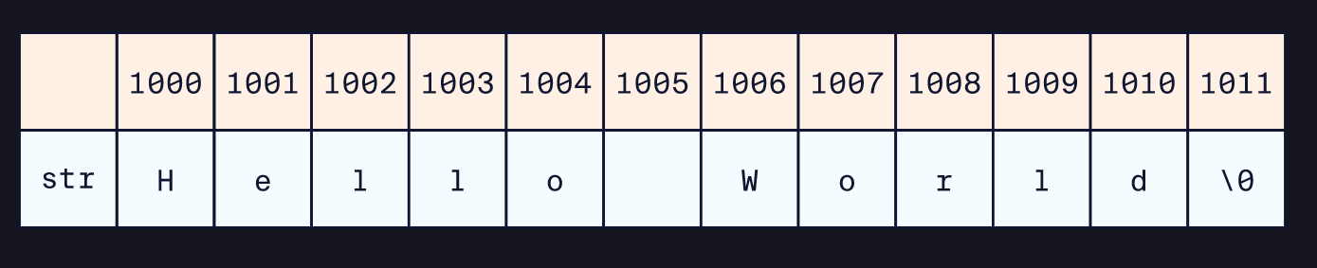
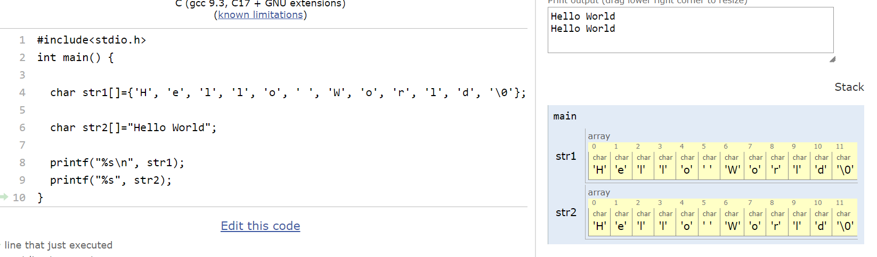
4.7 Array String
The first way is to simply create an initialized array of characters populated by the characters of the string.
char str[] = {'H', 'e', 'l', 'l', 'o', ' ', 'W', 'o', 'r', 'l', 'd', '\0’};
There are two important things to note here:
A blank space is a character, so it is included by putting a space in single quotes.
The very last character in the array is \0 known as the null terminating character. It signifies the end of the string and must be included when creating a string as an initialized array.
The string “Hello World” has 11 characters in it (space is a character too!) but the size of str[] is 12: 11 characters for “Hello World” plus one for the null character.
The second way to create a string variable in C is to use what is called a string literal. This is the creation of a string by initializing the char array with the full string in double quotes like so:
char str[] = "Hello World";
The only benefit to creating a string in this way is that it’s easier to type and the null terminating character (‘\0’) is added implicitly. The size of this array is still 12 for the same reasons mentioned before.

Slide 13
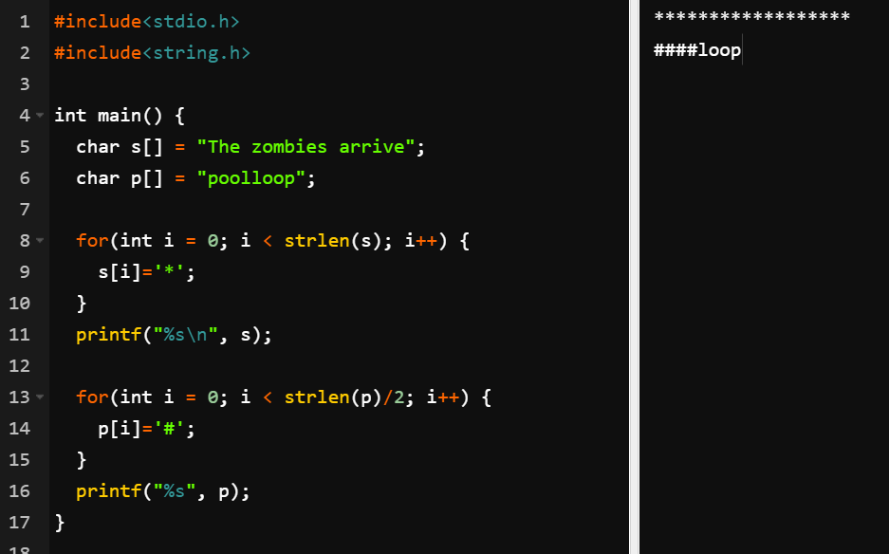
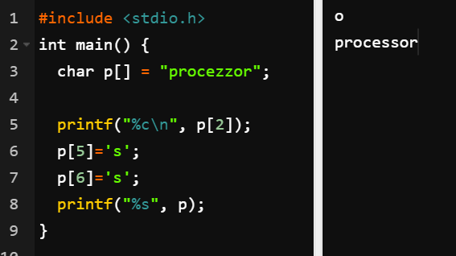
4.7 Array String: loop
strlen() from #include<string.h> does not account for the null terminating character.
A string cannot be extended to add new characters, and a character in a string cannot be deleted!
Notes:
#include <stdio.h>
int main() {
char p[] = "procezzor";
printf("%c\n", p[2]);
p[5]='s';
p[6]='s';
printf("%s", p);
}

Slide 14
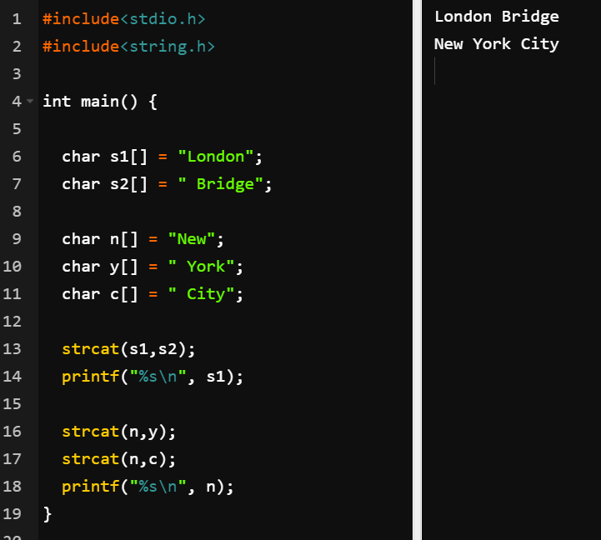
4.8 Concatenating Strings
The strcat() function takes one string, src, and appends it to the end of another string, dst. Using this function does not create a separate third string, but modifies the dst string to include the src string at the end. The syntax for this is:
strcat(dst, src);
char *strcat(char *destination, const char *source)
Notes:
#include<stdio.h>
#include<string.h>
int main() {
char s1[] = "London";
char s2[] = " Bridge";
char n[] = "New";
char y[] = " York";
char c[] = " City";
strcat(s1,s2);
printf("%s\n", s1);
strcat(n,y);
strcat(n,c);
printf("%s\n", n);
}

Slide 15
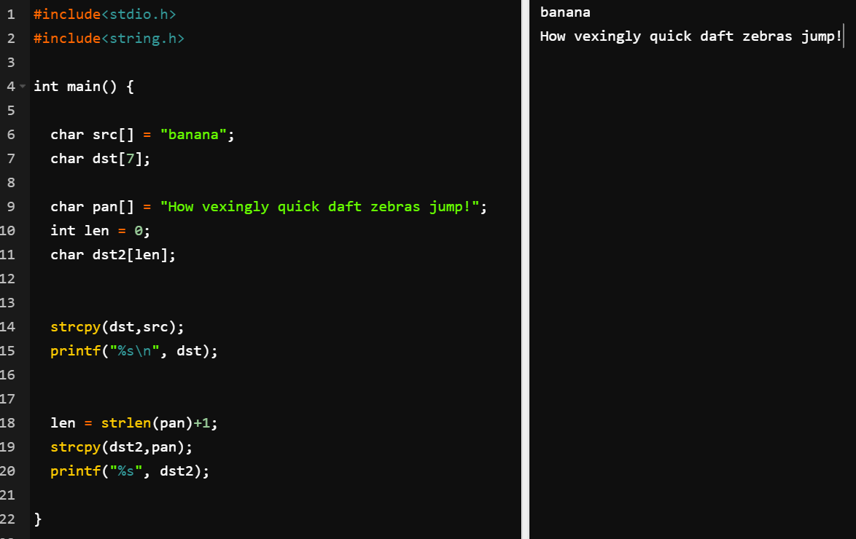
4.9 Copying Strings
strcpy() function which is used to copy a string into an empty character array (empty string). The syntax for this function is this:
strcpy(dst, src);
char* strcpy(char* destination, const char* source);
Given a string src and an empty string (empty character array) dst, the strcpy() function copies the contents of the src string into the dst string. It is important that the size of the empty character array, dst, be greater than or equal to the length of the string src plus one for the null character (‘\0’) in order to accommodate all incoming characters. If the dst char array is too short, the program will exhibit undefined behavior. Similar to the strcat() function, a new string will not be created.
Notes:
#include<stdio.h>
#include<string.h>
int main() {
char src[] = "banana";
char dst[7];
char pan[] = "How vexingly quick daft zebras jump!";
int len = 0;
char dst2[len];
strcpy(dst,src);
printf("%s\n", dst);
len = strlen(pan)+1;
strcpy(dst2,pan);
printf("%s", dst2);
}

Slide 16

References
Each Reference is indicated on the footer on each slide.
Books:
The_C_Programming_Language_(2nd_Edition_Ritchie_Kernighan)
Learn to Program with C_ Learn to Program using the Popular C Programming Language (Noel Kalicharan)
C How to Program, 8th edition, Paul Deitel and Harvey Deitel, Pearson, 2016.

Slide 17


Thank You
Nazrin Dolkhanova Sultanli
Nazrin.Sultanli.Dolkhanova@bhos.edu.az
Baku Higher Oil School

